Slide 1
chaper 2
e
Introduction to
Structured Query
Language

Slide 2
5. SQL Enhancements for Querying a Single Table
We started our discussion of SQL queries with SQL statements for processing a single table, and now we will add an additional SQL feature to those queries. As we proceed, you will begin to see how powerful SQL can be for querying databases and for creating information from existing data.
By the way The SQL results shown in this chapter were generated using Microsoft SQL
Server 2008 R2. Query results from other DBMS products will be similar,
but may vary a bit.

Slide 3
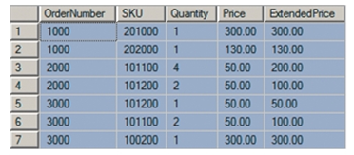
5. SQL Enhancements for Querying a Single Table
Sorting the SQL Query Results
The order of the rows produced by an SQL statement is arbitrary and determined by programs in the bowels of each DBMS. If you want the DBMS to display the rows in a particular order, you can use the SQL ORDER BY clause. For example, the SQL statement:
/* *** SQL-Query-CH02-10 *** */
SELECT *
FROM ORDER_ITEM
ORDER BY OrderNumber;
will generate the following results:

Slide 4
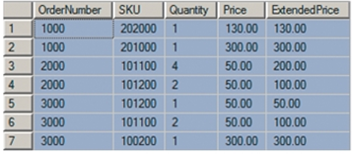
5. SQL Enhancements for Querying a Single Table
Sorting the SQL Query Results
We can sort by two columns by adding a second column name. For example, to sort first by OrderNumber and then by Price within OrderNumber, we use the following SQL query:
/* *** SQL-Query-CH02-11 *** */
SELECT *
FROM ORDER_ITEM
ORDER BY OrderNumber, Price;
The result for this query is:

Slide 5
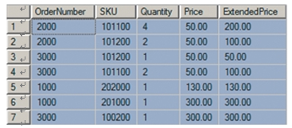
5. SQL Enhancements for Querying a Single Table
Sorting the SQL Query Results
If we want to sort the data by Price and then by OrderNumber, we would simply reverse the order of those columns in the ORDER BY clause as follows:
/* *** SQL-Query-CH02-12 *** */
SELECT *
FROM ORDER_ITEM
ORDER BY Price, OrderNumber;
with the results:
By the way Note to
Microsoft
Access users:
Unlike the SQL Server output
shown here, Microsoft Access
displays dollar signs in the
output of currency data.

Slide 6
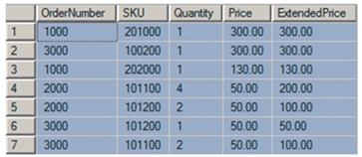
5. SQL Enhancements for Querying a Single Table
Sorting the SQL Query Results
By default, rows are sorted in ascending order. To sort in descending order, add the SQL DESC keyword after the column name. Thus, to sort first by Price in descending order and then by OrderNumber in ascending order, we use the SQL query:
/* *** SQL-Query-CH02-13 *** */
SELECT *
FROM ORDER_ITEM
ORDER BY Price DESC, OrderNumber ASC;
The result is:

Slide 7
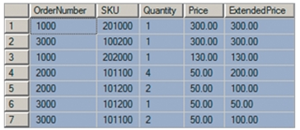
5. SQL Enhancements for Querying a Single Table
Sorting the SQL Query Results
Because the default order is ascending, it is not necessary to specify ASC in the last SQL statement. Thus, the following SQL statement is equivalent to the previous SQL query:
/* *** SQL-Query-CH02-14 *** */
SELECT *
FROM ORDER_ITEM
ORDER BY Price DESC, OrderNumber;
and produces the same results:

Slide 8

5. SQL Enhancements for Querying a Single Table
SQL WHERE Clause Options
SQL includes a number of SQL WHERE clause options that greatly expand SQL’s power and utility. In this section, we consider three options: compound clauses, ranges, and wildcards.
Compound WHERE Clauses
SQL WHERE clauses can include multiple conditions by using the SQL AND, OR, IN, and NOT IN operators. For example, to find all of the rows in SKU_DATA that have a Department named Water Sports and a Buyer named Nancy Meyers, we can use the SQL AND operator in our query code:
/* *** SQL-Query-CH02-15 *** */
SELECT *
FROM SKU_DATA
WHERE Department='Water Sports'
AND Buyer='Nancy Meyers';
The results of this query are:

Slide 9
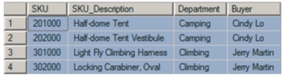
5. SQL Enhancements for Querying a Single Table
Similarly, to find all of the rows of SKU_DATA for either the Camping or
Climbing departments, we can use the SQL OR operator in the SQL query:
/* *** SQL-Query-CH02-16 *** */
SELECT *
FROM SKU_DATA
WHERE Department='Camping'
OR Department='Climbing';
which gives us the following results:

Slide 10
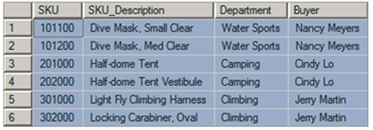
5. SQL Enhancements for Querying a Single Table
Three or more AND and OR conditions can be combined, but in such cases the SQL IN operator and the SQL NOT IN operator are easier to use. For example, suppose we want to obtain all of the rows in SKU_DATA for buyers Nancy Meyers, Cindy Lo, and Jerry Martin. We could construct a WHERE clause with two ANDs, but an easier way to do this is to use the IN operator, as illustrated in the SQL query:
/* *** SQL-Query-CH02-17 *** */
SELECT *
FROM SKU_DATA
WHERE Buyer IN ('Nancy Meyers', 'Cindy Lo', 'Jerry Martin');
In this format, a set of values is enclosed in parentheses. A row is selected if Buyer is equal to any one of the values provided. The result is:

Slide 11

5. SQL Enhancements for Querying a Single Table
Similarly, if we want to find rows of SKU_DATA for which the buyer is someone other than Nancy Meyers, Cindy Lo, or Jerry Martin, we would use the SQL query:
/* *** SQL-Query-CH02-18 *** */
SELECT *
FROM SKU_DATA
WHERE Buyer NOT IN ('Nancy Meyers', 'Cindy Lo', 'Jerry Martin');
The result is:
Observe an important difference between IN and NOT IN. A row qualifies for an IN condition if the column is equal to any of the values in the parentheses. However, a row qualifies for a NOT IN condition if it is not equal to all of the items in the parentheses.

Slide 12
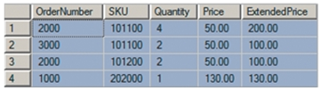
5. SQL Enhancements for Querying a Single Table
Ranges in SQL WHERE Clauses
SQL WHERE clauses can specify ranges of data values by using the SQL BETWEEN keyword. For example, the following SQL statement:
/* *** SQL-Query-CH02-19 *** */
SELECT *
FROM ORDER_ITEM
WHERE ExtendedPrice BETWEEN 100 AND 200;
will produce the following results:

Slide 13
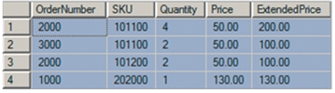
5. SQL Enhancements for Querying a Single Table
Ranges in SQL WHERE Clauses
Notice that both the ends of the range, 100 and 200, are included in the resulting table. The preceding SQL statement is equivalent to the SQL query:
/* *** SQL-Query-CH02-20 *** */
SELECT *
FROM ORDER_ITEM
WHERE ExtendedPrice >= 100
AND ExtendedPrice <= 200;
And which, of course, produces identical results:

Slide 14

5. SQL Enhancements for Querying a Single Table
Wildcards in SQL WHERE Clauses
The SQL LIKE keyword can be used in SQL WHERE clauses to specify matches on portions of column values. For example, suppose we want to find the rows in the SKU_DATA table for all buyers whose first name is Pete. To find such rows, we use the SQL keyword LIKE with the SQL percent sign (%) wildcard character, as shown in the SQL query:
/* *** SQL-Query-CH02-21 *** */
SELECT *
FROM SKU_DATA
WHERE Buyer LIKE 'Pete%';
When used as an SQL wildcard character, the percent symbol (%) stands for any sequence of characters. When used with the SQL LIKE keyword, the character string ‘Pete%’ means any sequence of characters that start with the letters Pete. The result of this query is:

Slide 15

5. SQL Enhancements for Querying a Single Table
Does Not Work
With MS Access
ANSI-89 SQL
Microsoft Access ANSI-89 SQL uses wildcards, but not the SQL-92 standard wildcards. Microsoft Access uses the Microsoft Access asterisk (*) wildcard character instead of a percent sign to represent multiple characters.
Solution: Use the Microsoft Access asterisk (*) wildcard in place of the SQL-92 percent sign (%) wildcard in Microsoft Access ANSI-89 SQL statements. Thus, the preceding
SQL query would be written as follows for Microsoft
Access:
/* *** SQL-Query-CH02-21-Access *** */
SELECT *
FROM SKU_DATA
WHERE Buyer LIKE 'Pete*';

Slide 16

5. SQL Enhancements for Querying a Single Table
Suppose we want to find the rows in SKU_DATA for which the SKU_Description includes the word Tent somewhere in the description. Because the word Tent could be at the front, the end, or in the middle, we need to place a wildcard on both ends of the LIKE phrase, as follows:
/* *** SQL-Query-CH02-22 *** */
SELECT *
FROM SKU_DATA
WHERE Buyer LIKE '%Tent%';
This query will find rows in which the word Tent occurs in any place in the SKU_Description. The result is:

Slide 17
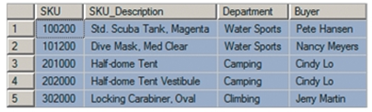
5. SQL Enhancements for Querying a Single Table
Sometimes we need to search for a particular value in a particular location in the column. For example, assume SKU values are coded such that a 2 in the third position from the right has some particular significance, maybe it means that the product is a variation of another product. For whatever reason, assume that we need to find all SKUs that have a 2 in the third column from the right. Suppose we try the SQL query:
/* *** SQL-Query-CH02-23 *** */
SELECT *
FROM SKU_DATA
WHERE SKU LIKE '%2%';
The result is:

Slide 18

5. SQL Enhancements for Querying a Single Table
This is not what we wanted. We mistakenly retrieved all rows that had a 2 in any position in the value of SKU. To find the products we want, we cannot use the SQL wildcard character %. Instead, we must use the SQL underscore ( _ ) wildcard character, which represents a single, unspecified character in a specific position. The following SQL statement will find all SKU_DATA rows with a value of 2 in the third position from the right:
/* *** SQL-Query-CH02-24 *** */
SELECT *
FROM SKU_DATA
WHERE SKU LIKE '%2__';
Observe that there are two underscores in this SQL query— one for the first position on the right and another for the second position on the right. This query gives us the result that we want:

Slide 19

5. SQL Enhancements for Querying a Single Table
Does Not Work
With MS Access
ANSI-89 SQL
Microsoft Access ANSI-89 SQL uses wildcards, but not the SQL-92 standard wildcards. Microsoft Access uses the Microsoft Access question mark (?) wildcard character instead of an underscore (_) to represent a single character.
Solution: Use the Microsoft Access question mark (?) wildcard in place of the SQL-92 underscore (_) wildcard in Microsoft Access ANSI-89 SQL statements. Thus, the preceding SQL query would be written as follows for Microsoft Access:
/* *** SQL-Query-CH02-24-Access *** */
SELECT *
FROM SKU_DATA
WHERE SKU LIKE '*2??';
Furthermore, Microsoft Access can sometimes be fussy about stored trailing spaces in a text field. You may have problems with a WHERE clause like this:
WHERE SKU LIKE '10?200';
Solution: Use a trailing asterisk (*), which allows for the trailing spaces:
WHERE SKU LIKE '10?200*';

Slide 20
5. SQL Enhancements for Querying a Single Table
By the way The SQL wildcard percent sign (%) and underscore (_) characters are
specified in the SQL-92 standard. They are accepted by all DBMS products
except Microsoft Access. So, why does Microsoft Access use the asterisk (*) character
instead of the percent sign (%) and the question mark (?) instead of the underscore?
This difference probably exists because the designers of Microsoft Access chose to use
the same wildcard characters that Microsoft was already using in the Microsoft
MS-DOS operating system.

Slide 21
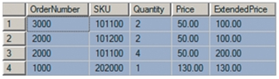
5. SQL Enhancements for Querying a Single Table
Combining the SQL WHERE Clause and the SQL ORDER BY Clause
If we want to sort the results generated by these enhanced SQL WHERE clauses, we simply combine the SQL ORDER BY clause with the WHERE clause. This is illustrated by the following SQL query:
/* *** SQL-Query-CH02-25 *** */
SELECT *
FROM ORDER_ITEM
WHERE ExtendedPrice BETWEEN 100 AND 200
ORDER BY OrderNumber DESC;
which will produce the following result:

Slide 22
Thank You!
LOGO

